Slide 1
Measurements in the Ocean
Peter Challenor
University of Exeter
and
National Oceanography Centre

Slide 2
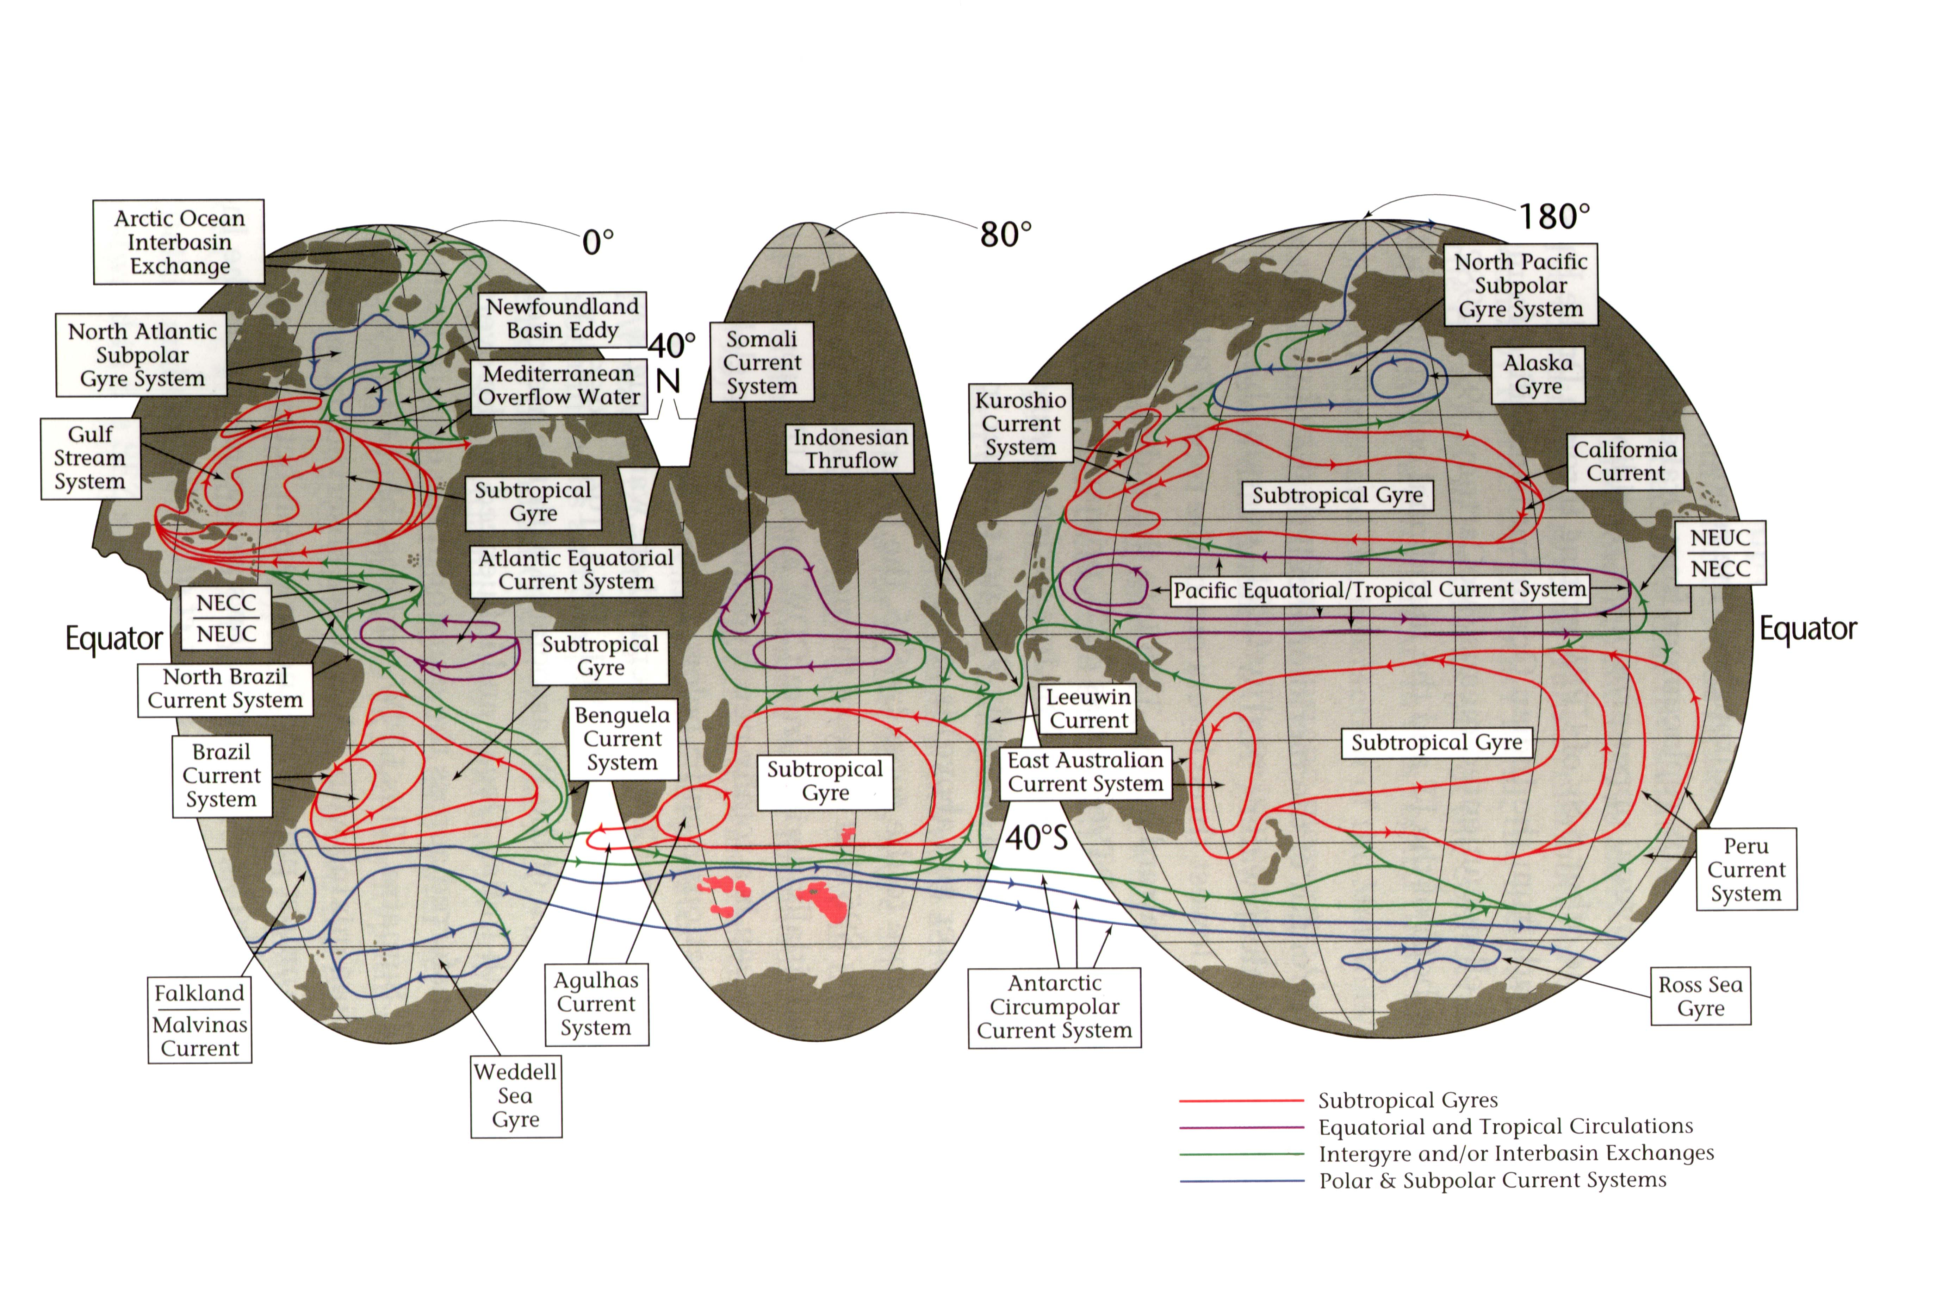

Slide 3
What is Measured
Temperature and Salinity – Density
Bottom Pressure
Velocity
Tracer Chemistry

Slide 4
Geostrophy
Combining and integrating
So we take density changes relative to a reference level, z₀,
and we can calculate the velocity between any two columns
of density measurements
Notes:
fv=-\frac{1}{\rho}\frac{\partial p}{\partial x}
0=-\frac{\partial p}{\partial x} - g \rho
\rho v = \frac{g}{f}\int_{z_0}^{z}\frac{\partial \rho}{\partial x} + b

Slide 5
Temperature and Salinity from Research Ships

Slide 6
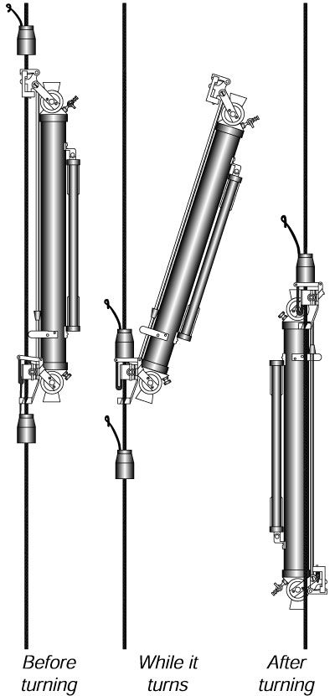
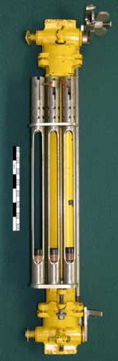
The Reversing Thermometer
Main Instrument for temperature pre-1970
Sd 0.01K (Quadfasel et al 1990)

Slide 7
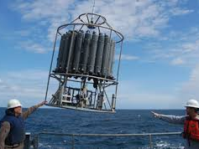
CTD – conductivity, temperature and depth

Slide 8
Salinty
Salinity is measured by the conductivity
This measurement needs to be calibrated
This is done on board ship from water samples with a salinometer

Slide 9
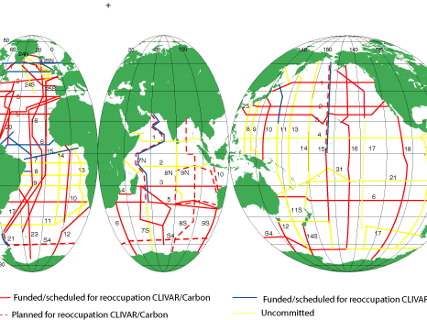
Repeat Hydrography

Slide 10
Expendable Probes

Slide 11
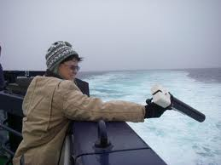
The Expendable BathyThermograph (XBT)
Only measures temperature. Depth comes from drop rate.
Widely used by navies and some commercial ships.
Recent corrections to drop rate

Slide 12
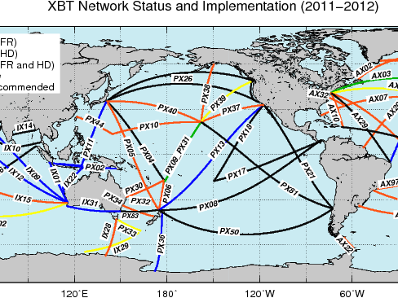
Routine XBT Coverage

Slide 13
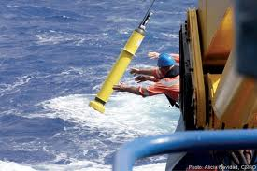
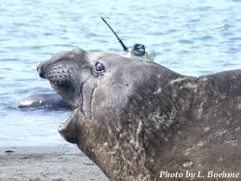
Floats and Seals

Slide 14
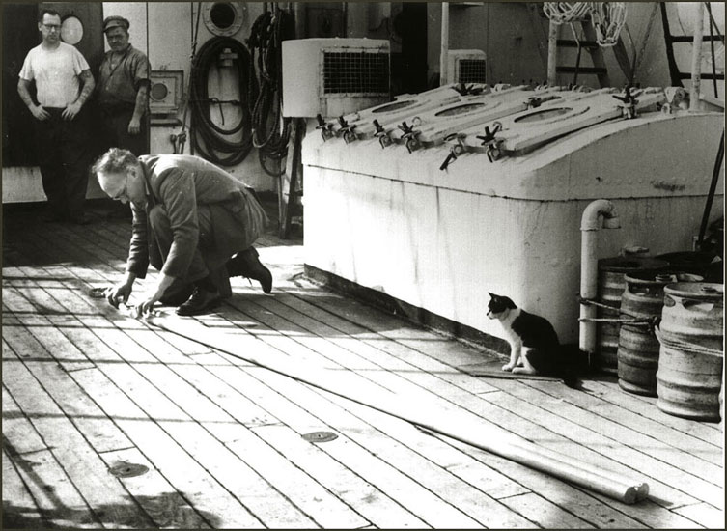
Floats

Slide 15
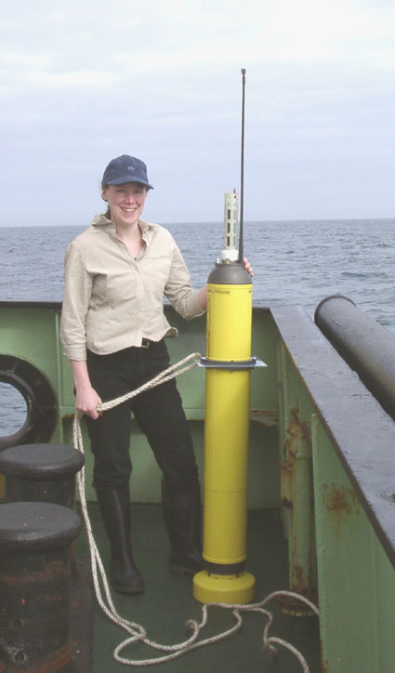
ARGO floats
Notes:
Float at 1000 or 2000 m depth.
Every ten days pop up to surface measuring T&S
Salinity is calibrated from ship data

Slide 16
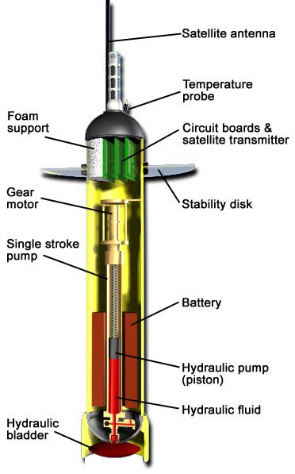

Slide 17
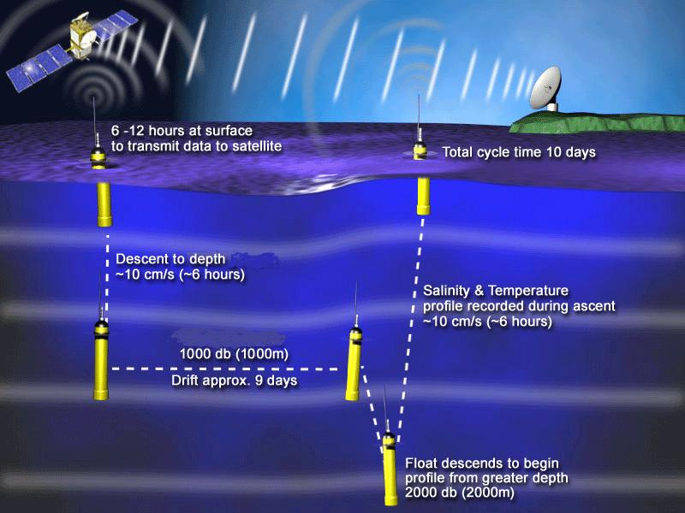

Slide 18
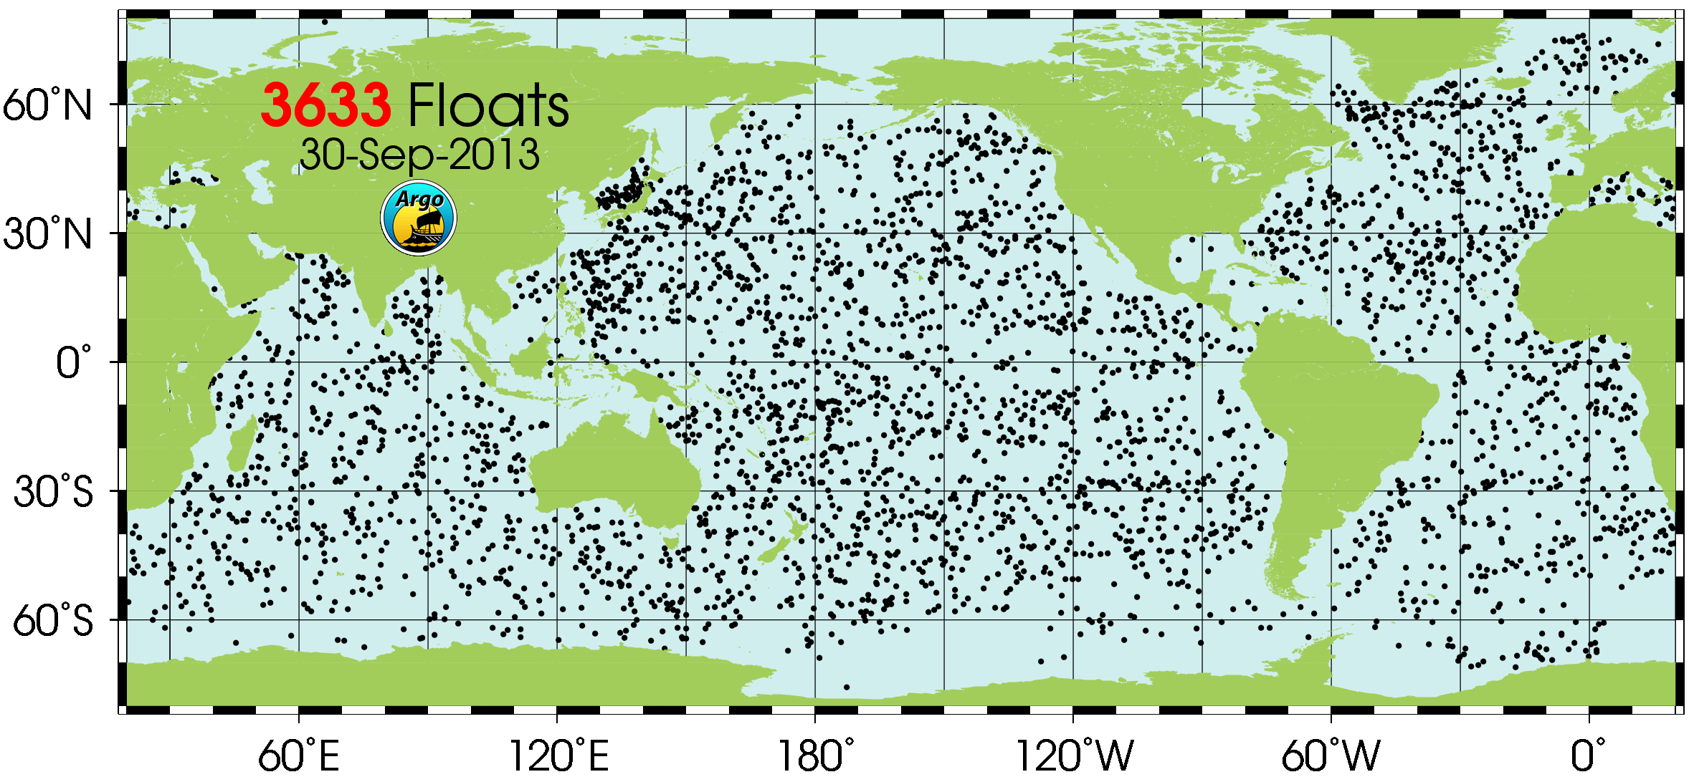
The current ARGO network

Slide 19
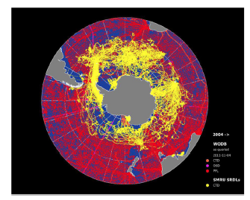
Data from Marine Mammals

Slide 20
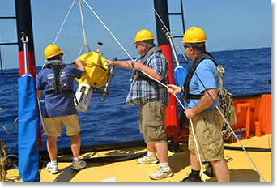
Experimental full depth ARGO floats

Slide 21
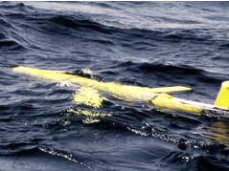
Gliders

Slide 22
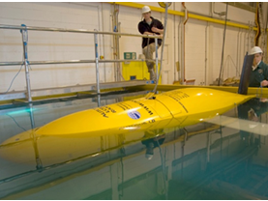
Autosub

Slide 23
Velocity measurements

Slide 24
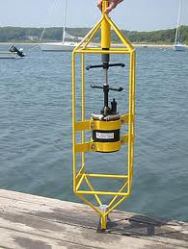
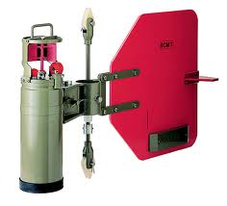
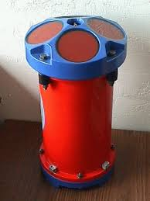
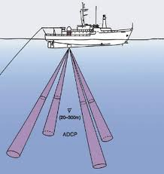
Current Meters

Slide 25
Moorings

Slide 27
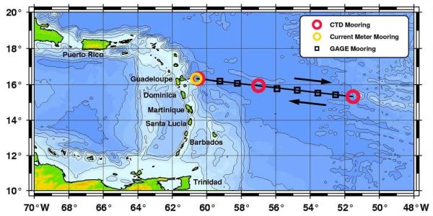
MOVE Array

Slide 28
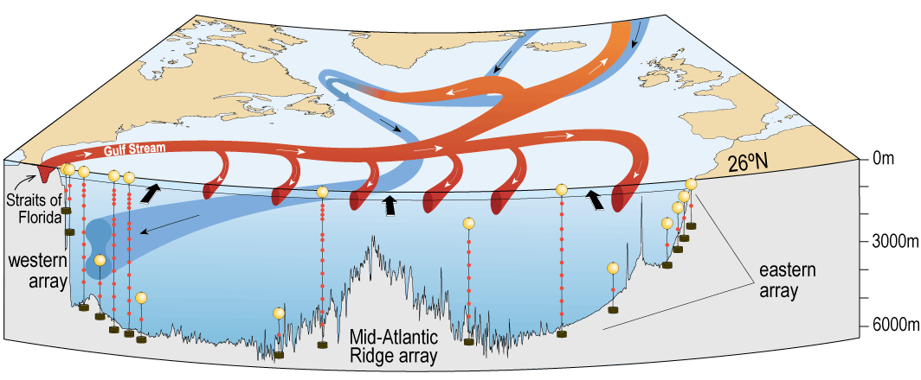

RAPID @ 26.5˚N (2004-2014)
Measuring the strength and vertical structure of the Atlantic Meridional Overturning Circulation (AMOC) and associated heat transport
Cunningham, S. A., et al. (2007), Temporal variability of the Atlantic Meridional Overturning Circulation at 26.5°N, Science, 317, 935-938.
Kanzow, T., et al. (2007), Observed flow compensation associated with the MOC at 26.5°N in the Atlantic, Science, 317, 938-941.

Slide 29
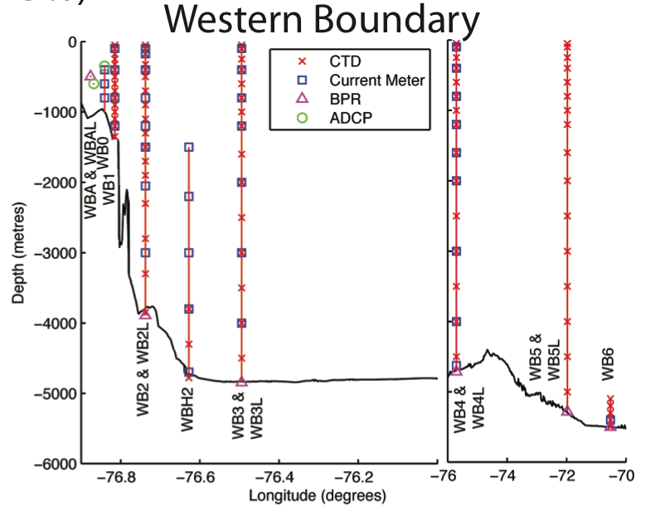
The array

Slide 30
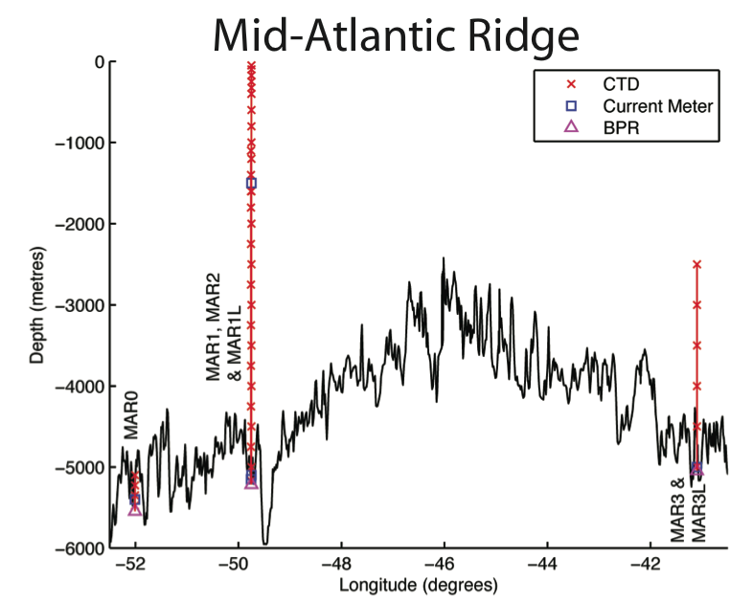
The array

Slide 31
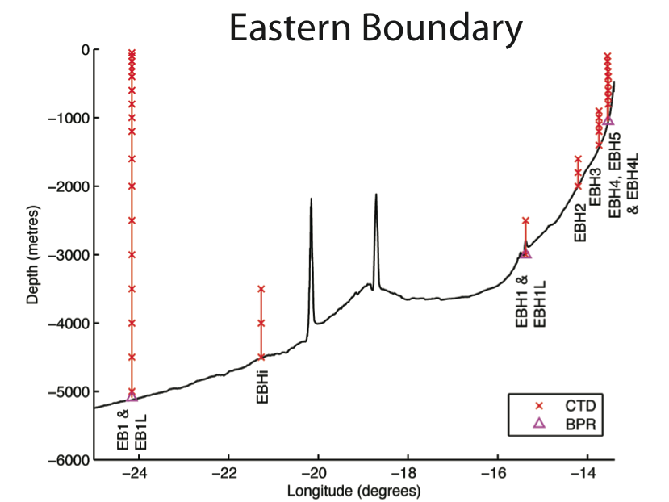
The array

Slide 32
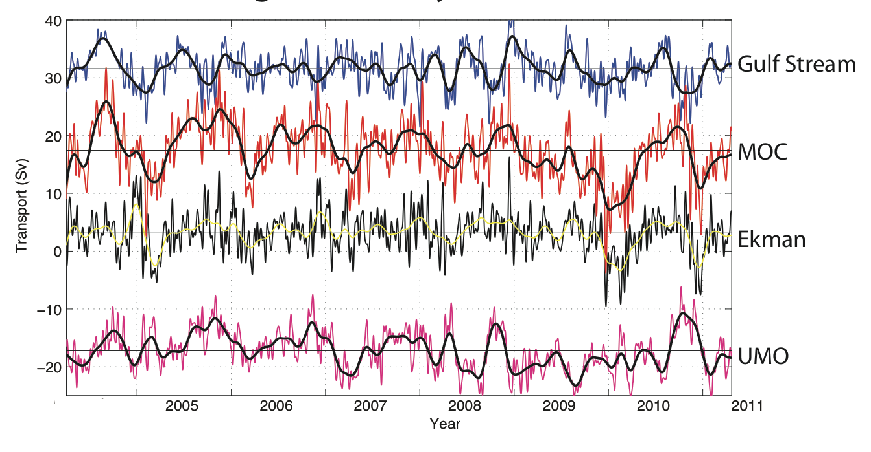
RAPID MOC time series: since 2004

Slide 33
Tracer Chemistry
The ocean dissolves gases from the atmosphere
Anthropogenic gases – Tritium, CFC, … – have known atmospheric concentrations with time.
Knowing the dissolution rate we can estimate the time since any sample of water was at the surface

Slide 34
Motivation: How much anthropogenic carbon does the ocean take up?
Sabine et al, Science, 2004
Where does the ocean take up carbon?
How might the uptake of carbon respond to further changes in the climate system?

Slide 35
World Ocean Database 2013
Collects all oceanographic data
http://www.nodc.noaa.gov/OC5/WOD/pr_wod.html

Slide 36
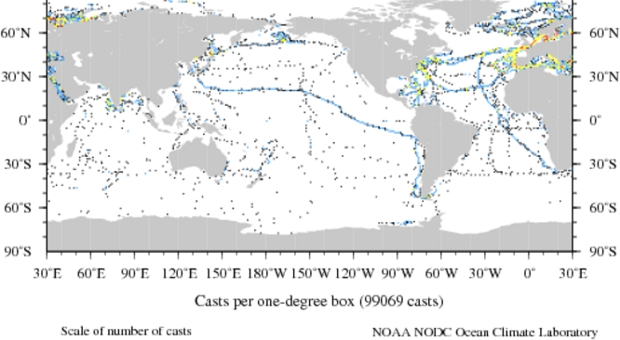
Pre-1900

Slide 37
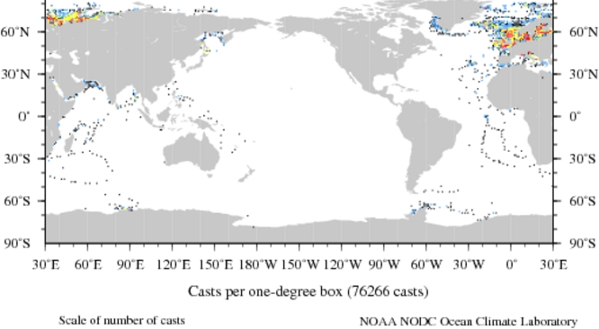
1900-1909

Slide 38
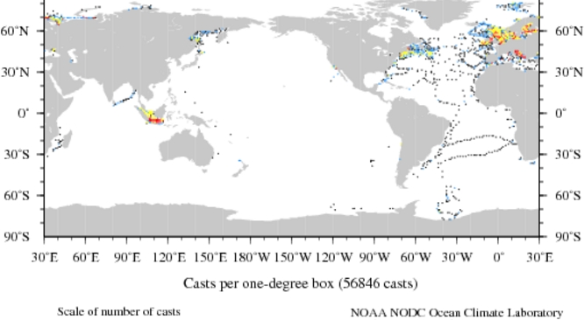
1910-1919

Slide 39
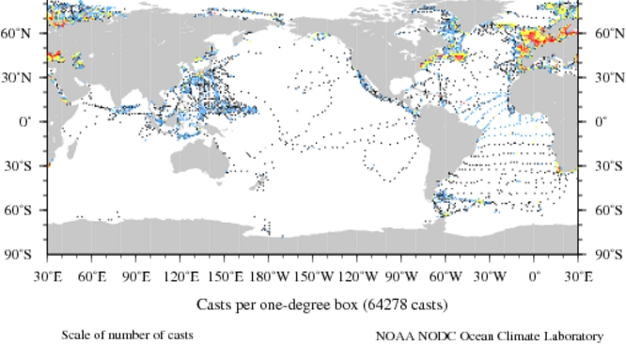
1920-1929

Slide 40
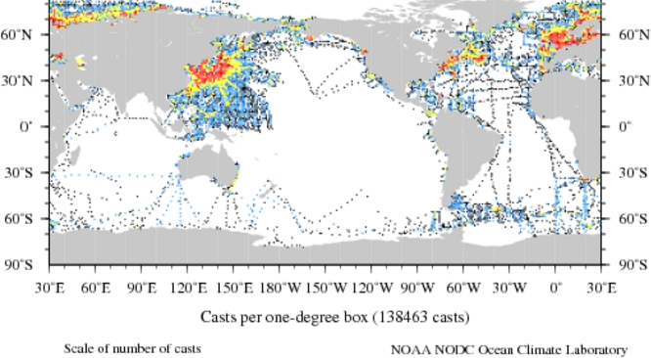
1930-1939

Slide 41
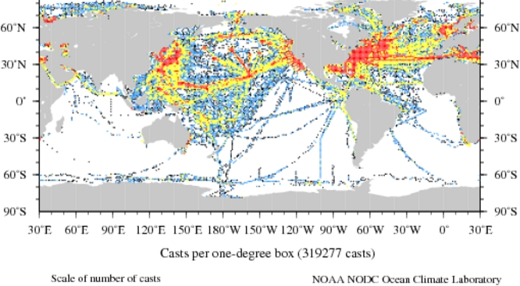
1940-1949

Slide 42
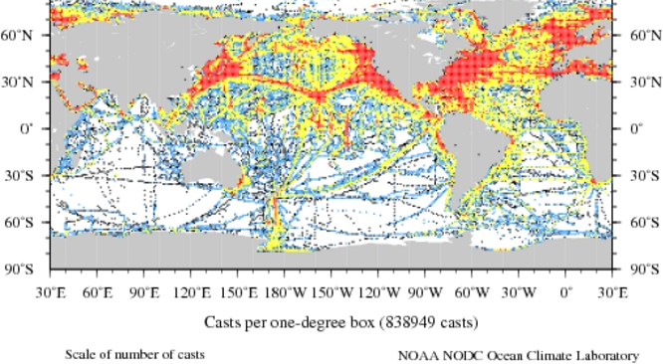
1950-1959

Slide 43
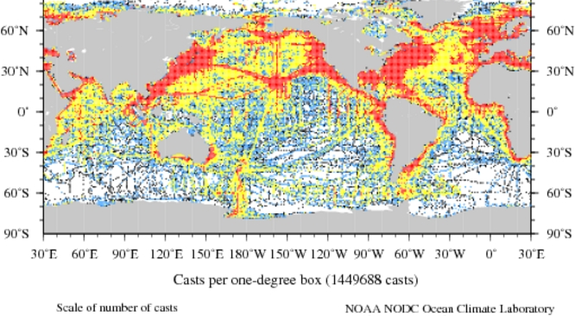
1960-1969

Slide 44
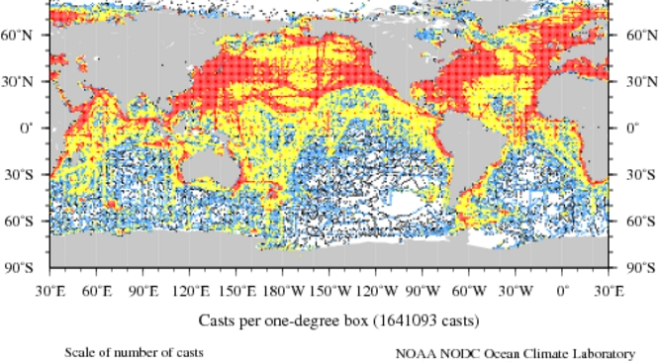
1970-1979

Slide 45
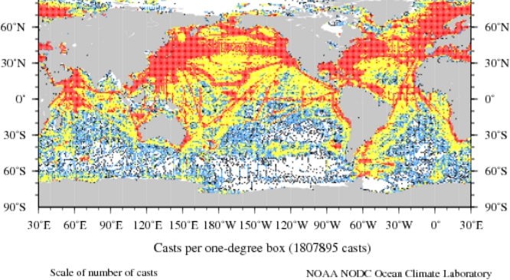
1980-1989

Slide 46
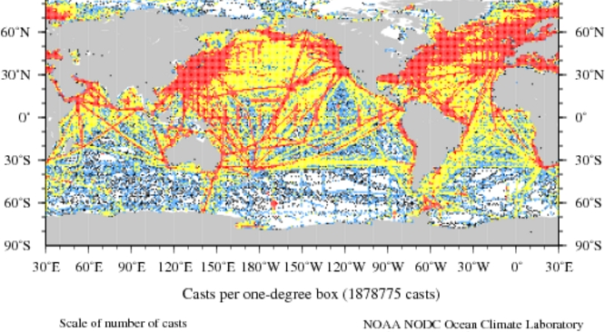
1990-1999

Slide 47
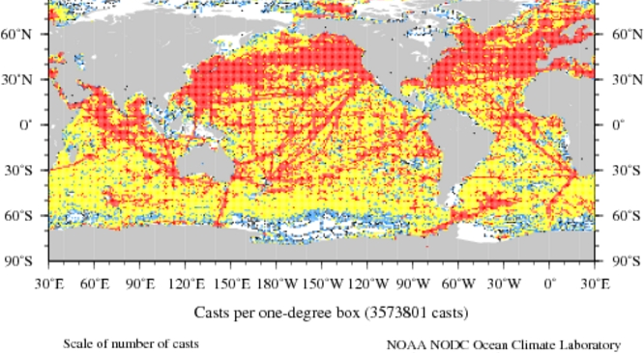
2000-2009

Slide 48
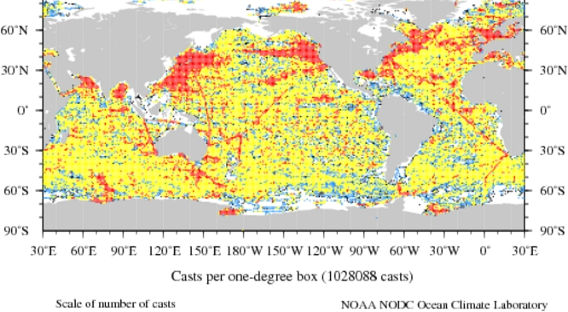
2010-Present

Slide 49
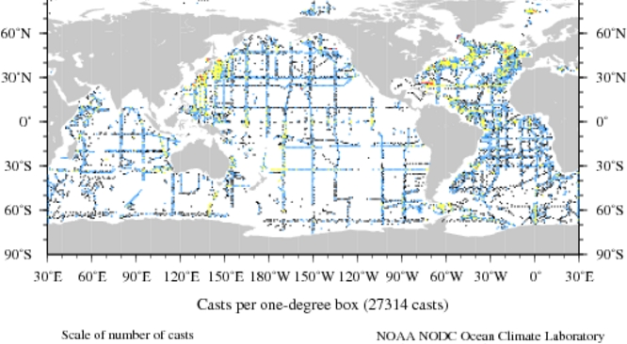
Post 1980 CTD 3500m+

Slide 50
World Ocean Atlas 2009
‘Objectively Analysed’ mean field + s.d. at 1°and 5° resolution at fixed depth levels
http://www.nodc.noaa.gov/OC5/WOA09/pr_woa09.html

Slide 51
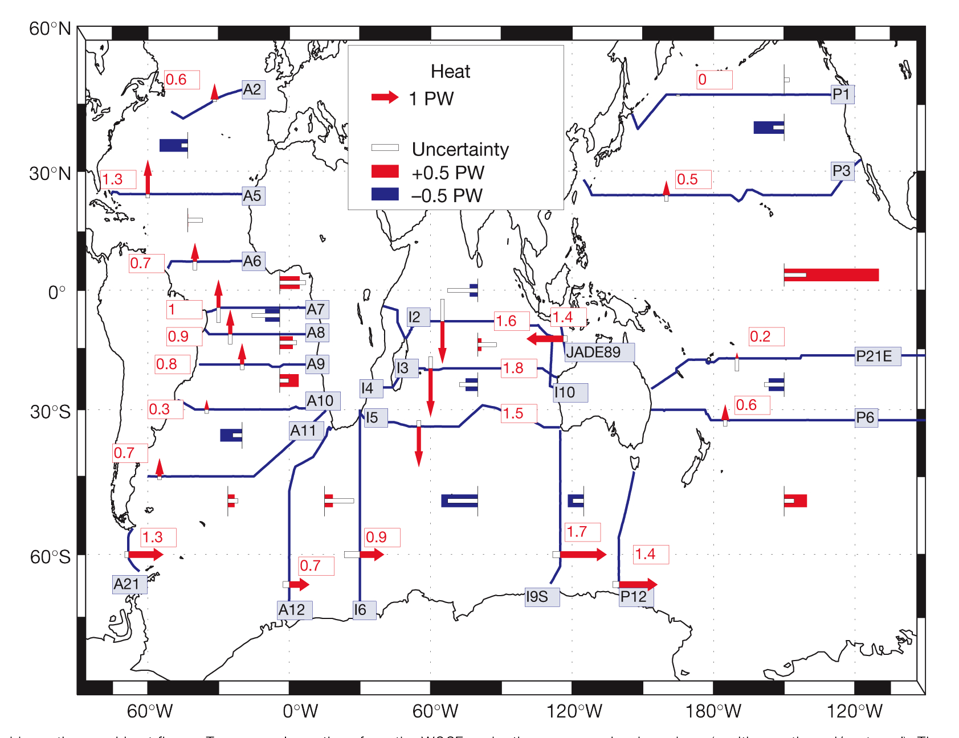
Inverse Solutions
^{Ganachaud & Wunsch (2000)}

Slide 52
Reanalyses
Combine data with ocean models via data assimilation
  ECCO
  SODA
  ECMWF

Slide 53
Some Statistical Issues
Modelling T&S simultaneously (Sahu and Challenor 2008)
3-d analysis
Analysis along density levels rather than pressure or depth levels
Spatio-temporal modelling with data at varying locations

