Slide 1
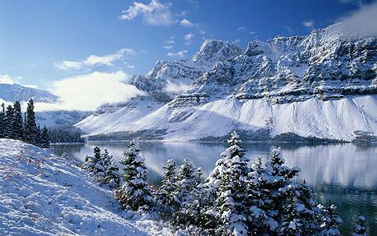
Probing the IR of geometries with hyperscaling violation
Sera Cremonini
Cambridge and Texas A&M

Slide 2
Theme of Banff 2013:
holography as a new set of (analytic) tools to tackle the dynamics of systems that are strongly coupled
QCD deconfinement transition
→ applications to transport properties of the sQGP (celebrated η/s=1/4π)
quantum critical points + novel phases of matter with unconventional scalings
systems whose underlying degrees of freedom believed to be strongly coupled
Effort underway to probe/classify phase structure of these systems, in particular in deep infrared (vacuum structure) and for cases with reduced symmetries

Slide 3
These questions have been geometrized in a number of ways
simplest incarnations: scalars driving phase transitions
Scaling geometries → useful laboratory for modeling behavior around QCP
Also lead to a number of puzzles about the nature of the ground state of the systems they are meant to describe
Plan:
arXiv:1208.1752
J. Bhattacharya, S.C. , A. Sinkovics
arXiv:1212.4172
S.C. + A. Sinkovics
baby step towards understanding IR endpoint of (certain) scaling solutions
further evidence that their ground state may be spatially modulated phases

Slide 4
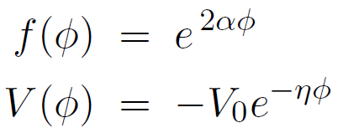
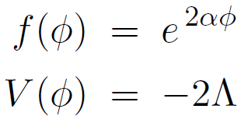
Generating Lifshitz-like scaling and hyperscaling violation
Simple Einstein-Maxwell-dilaton theories
Appealing feature →
however uplift to higher D → naïve scaling restored (Gouteraux/Kiritsis)
Hyperscaling violation shifts effective dimensionality of system
at finite density, θ=d-1 of interest for probing compressible states of matter
also FS signature (S_{ent}~ A log A) [Huijse/Sachdev/Swingle, Takayanagi et al.]
Subtleties for density-density correlators (Hartnoll/Shagoulian, Iqbal/Faulkner…)

Slide 5
Scaling solutions supported by a running dilatonic scalar φ ~ log r
→ not expected to describe geometry accurately in the deep IR
Effective gauge coupling of the theory drives system to
strong coupling (magnetic case)
weak coupling (electric case)
Expect modifications to g,
for example
Expect higher derivative terms no longer negligible
Solutions also known to suffer from singularities (curvature + tidal)
see e.g. Horowitz/Way, Bao/Dong/Harrison/Silverstein for pure Lifshitz
Copsey/Mann → hyperscaling violation

Slide 6
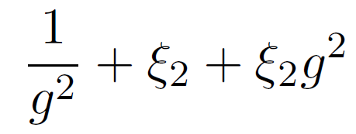
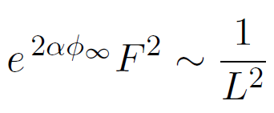
Natural question: IR endpoint of scaling solutions?
For the Lifshitz-like magnetic case, simple loop corrections give rise to
AdS₂ x R² in the IR [Harrison/Kachru/Wang 1202.6635]
Add irrelevant perturbations to the IR AdS₂ → flow to AdS₄ in the UV
AdS₂ x R²
Lifshitz-like regime
AdS₄
deep IR
UV

Slide 7
`IR completion’ of hyperscaling violation
[arXiv:1208.1752 – purely magnetic case]
Similar reasoning can be applied to solutions with hyperscaling violation
(run-away scalar, singularities)
Main difference → supported by non-trivial scalar potential
Our interest:
explore conditions for emergence of deep IR AdS₂ x R² description (with AdS₄ UV completion) in geometries exhibiting (z, θ) scaling regime
reiterate idea that scaling geometries should be thought of as `intermediate’

Slide 8
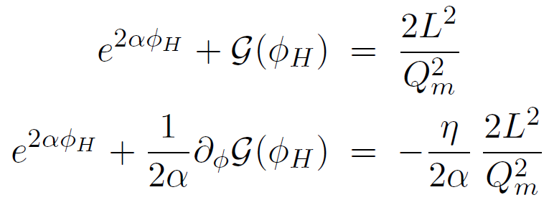
`IR completion’ of hyperscaling violation
Our starting point for generating (z, θ) scaling solutions:
also in a number of constructions with more involved scalar potentials
For this particular system (potential left unchanged) AdS₂ x R² in deep IR only for special case η = -2α (or θ=2)
Appropriate IR modifications to f (φ) (and V (φ) more broadly) give AdS₂ x R² completion → toy model for loop corrections as particular example

Slide 9
`IR completion’ of hyperscaling violation
Our starting point for generating (z, θ) scaling solutions:
also in a number of constructions with more involved scalar potentials
For this particular system (potential left unchanged) AdS₂ x R² in deep IR only for special case η = -2α (or θ=2)
Appropriate IR modifications to f (φ) (and V (φ) more broadly) give AdS₂ x R² completion → toy model for loop corrections as particular example
AdS₂ x R²
(z,θ) regime
AdS₄
deep IR
UV

Slide 10
Flows of this type seen in a number of places, at classical level:
Entangled dilaton dyons [Trivedi et al, 1208.2008]
dyonic charges give stabilizing potential for dilaton (attractor)
`fragile’ FS → small B field drastically changes S_{ent}
U(1)⁴ truncation of N=8, D=4 gauged SUGRA [Donos,Gauntlett,Pantelidou, 1212.1462]
intermediate η-geometry when q << Q_{other} → charge as resolution mechanism
(double scaling limit, Hartnoll/Shaghoulian)
Also IIB truncations to 5D [Kulaxizi, Parnachev, Schalm 1208.2937]
→ flows to IR η-geometry in IR , conformal to AdS₂ x R³
…
AdS₂ x R²
(z, θ)
AdS₄
double scaling limit

Slide 11
Spatially modulated instabilities
[arXiv:1212.4172]
Given emergence of IR AdS₂ factor, new puzzle:
well-known extensive ground state entropy of AdS₂ x R²
not expected to describe true ground state of system
→ not ultimate endpoint of scaling geometries
AdS₂ x R² known to suffer from spatially modulated instabilities (at finite k)
(e.g. Ooguri et al, Donos/Gauntlett/Pantelidou, …)
Our logic:
use knowledge of instabilities of IR AdS₂ region to explore which (z, θ) scaling geometries may be unstable to spatially modulated phases

Slide 12
Steps:
Back to simple EMD model:
Require f (φ) and V (φ) to give AdS₂ x R² in the deep IR (constraints)
Study spatially modulated perturbations of near-horizon AdS₂ x R² :
(following logic of Donos/Gauntlett/Pantelidou 1109.0471)
Ask whether any modes violate AdS₂ bound
→ instability conditions for generic f (φ_{h}) and V (φ_{h}) (purely B field case)
Map to conditions on (z, θ) by requiring f (φ) and V (φ) to support intermediate scaling region

Slide 13
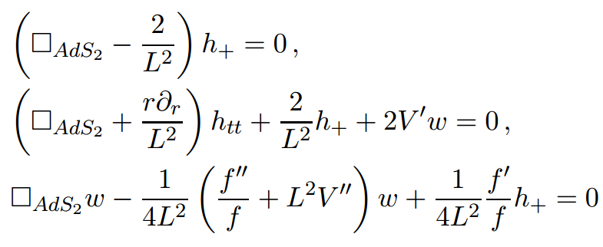
Spectrum of scaling dimension
k=0 case
Don’t expect instabilities for AdS₂ x R² (e.g. Almuhairi/Polchinski, Donos et al)
two perturbations a(r) and h_{xx} – h_{yy} decouple
Only contribution potentially dangerous:
Potential instabilities controlled by curvature of effective scalar potential
none if scalar settles to min of its effective potential (e.g. AdS₂ x R²)
(new sources of instability when critical point is not a min)

Slide 14
Spectrum of scaling dimension
Finite k case
system can be reduced to four perturbations
structure significantly more complicated, but in small k approximation
AdS₂ x R² unstable to spatial modulations (for some k-range) whenever
so far generic scalar potential and gauge kinetic function
only assumptions →IR AdS₂ x R² and constant background B field

Slide 15
Connecting to intermediate scaling regime
Require f (φ) and V (φ) to give rise to intermediate scaling regime
simple example, racetrack potential:
→ instabilities when
If effective potential fully specifed, get conditions on exponents (z,θ )
e.g. cosh potential → unstable in IR when
special case: when θ = 1 we find instabilities for z < 8
Also, given some (z,θ ), you can use these relations to constrain the form of f (φ) and V (φ) needed to obtain/avoid IR instabilities

Slide 16
To wrap up…
Simple point:
we can use knowledge of deep IR instabilities (here AdS₂ x R²) to make statements about possible ground state of scaling solutions
→ evidence for spatially modulated phases
here done for a very simple EMD model, with B field only, and for static perturbations
similar logic should apply to other setups, in particular for electric field case → more relevant to CM applications to systems with FS
Recent work in that direction by Iizuka + Maeda, 1301.5677
EMdilaton/axion, perturb hyperscaling violating region itself
→ instabilities driven by axion term, interesting temperature enhancement
(critical axion value decreases as T approaches zero)

Slide 17
A few questions…
we saw the onset of instabilities to spatially modulated phases
→ fully backreacted geometry? (e.g. Ooguri/Park, Donos/Gauntlett)
any notion of universality for values of (z,θ) linked to IR instabilities?
how does instability story connect to recent work on classifying extremal horizons w/ reduced symmetries + Nernst geometries? (Iizuka et al, Haack et al)
what can we learn by uplifiting scaling solutions to higher D?
e.g. Gouteraux/Kiritsis et al
what about (classically) stable susy ads2 solutions? can we show instabilities with 1/N corrections?

Slide 18
Thank You

